Slide 1


An Intro to Arduino Programming
Notes:
Reference page 6 - 7 sparkfun manual

Slide 2
What is Programming?
Basically, “speaking computer”
Telling a computer what to do by creating a set of instructions (algorithm) that it can interpret
Commands must be very specific -> “ computers are dumb”
Question: What are some applications for programming?
Focus on “C” programming language
High level, general purpose language used for a variety of applications
Originally used for UNIX operating system 30 + years ago
Basis for most newer languages

Slide 3
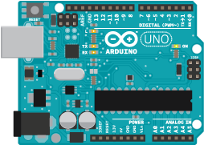
What is an Arduino?
Microcontroller -> many possible applications
Programmed in C language
Two sets of codes created for muscle car
Human Control code: takes in readings from muscle sensor and lights specified LED based on directional commands
Vehicle Control code: takes in Human Control readings via radio frequency and tells Arduino to move motors accordingly
Notes:
Code created by undergrads and phD candidates at CSU
Microcontroller is basically a small computer, an integrated circuit containing many components

Slide 4
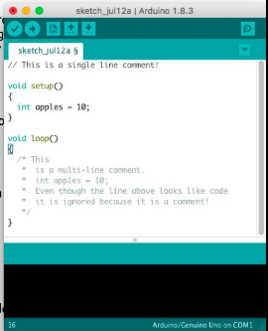
Syntax
Rules/grammar of a language
Comments: notes for user which are ignored by the computer
// single line comment
/**/ multi line comment
Notes:
Just like grammar in english class, computer needs us to talk to it in proper formatting in order for it to understand us

Slide 5
Syntax
; a semicolon ends every line of code
Common cause of errors!
Similar to a period in english
Don’t forget the semicolon!
{ } functions/loops are contained within curly brackets
Arduino programs MUST have two functions
setup function: runs ONCE when arduino is powered
loop function: runs until arduino loses power
Notes:
Just like grammar in english class, computer needs us to talk to it in proper formatting in order for it to understand us

Slide 6
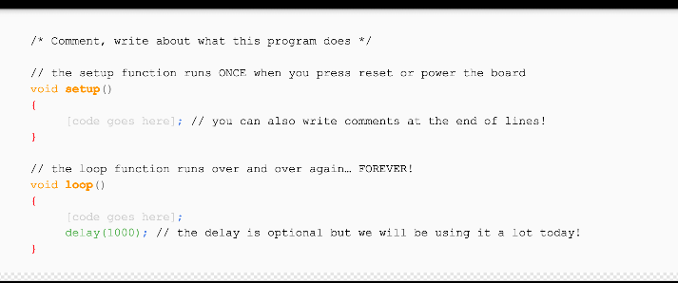
Basic Arduino Program Layout
Notes:
Just like grammar in english class, computer needs us to talk to it in proper formatting in order for it to understand us

Slide 7
Variables
A way of naming/storing values for later use by the program
Ex. data from a sensor, values used in multi-step equations
Can be named using any combo of letters or numbers, but cannot start with a number
Ex. variable1 is correct, 1variable is not
Variables MUST be declared before use
Must define data type before naming variable
char: character (ex. char)
int: integer (ex. int var1 = 10; )
float: decimal number (ex. float var2 = 20.20; )
long: larger int value
double: larger float value
Notes:
Int: whole numbers
Float: decimals
Double: stores long values
Char: stores a character using ASCII code

Slide 8
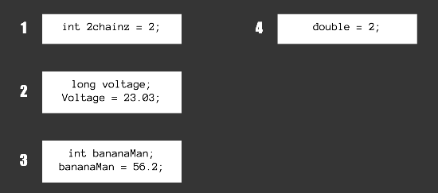
Common variable mistakes
Notes:
1. Variable names starts with a number
2. Voltage is not the same as voltage
3. Int variable must be integers
4. Double variables must be decimals

Slide 9
Numerical Operators
Addition +
Subtraction -
Division /
Multiplication *
Modulus %
Increment ++
Decrement --

Slide 10
Numerical Operators
Addition + A+B = 11.0
Subtraction - B-A = 1.0
Division / B/A = 1.200
Multiplication * A*B = 30.00
Modulus % B%A = 1.0
Increment ++ A++ = 6.0
Decrement -- B-- = 5.0
Let:
A = 5.0
B = 6.0

Slide 11
Statements
A command/function that provides an instruction to execute
Basic types:
if
else/if-else
for
if(var1 > 10)
{
statement;
}
else
{
statement1;
}
for (int i = 0; i < #repeats; i++)
{
statement;
}
if(condition)
{
statement;
}

Slide 12
Statement Conditions
Types of Conditions:
Equal (A==B)
Not equal to (A!=B)
Less than (A<B)
Greater than (A>B)
Less/equal to (A<=B)
Greater/equal to (A>=B)
Format:
statement_type(condition)
{
Statement
}
*note: when using characters,, they must have quotations around them (ex. ‘A’)

Slide 13
Digital and Analog Functions
Used to configure and communicate to Arduino
pinMode(pin, mode); sets pins mode (INPUT/OUTPUT) and number (0-19)
digitalWrite(pin, value); reads outputs and sets to HIGH or LOW
digitalRead(pin); reads inputs and returns whether it is HIGH or LOW
analogWrite(pin, value); some pins support pulse width modulation (turn pin on and off very quickly), value is between 0 and 255
analogRead(pin); reads inputs and returns whether it is HIGH or LOW
delay(ms) waits a specified time before proceeding to next statement
*note: a LOW value means off, a HIGH value means on

Slide 14
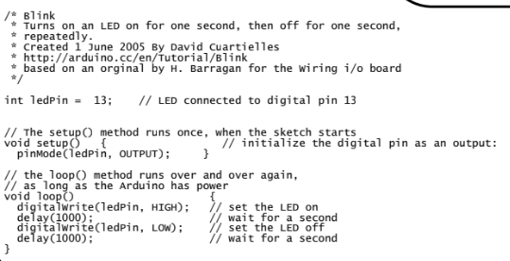
Arduino Code Example

Slide 15
Activity: Comment the muscle car code!
(Get into your groups)
Notes:
Print one copy of uncommented parts of codes per group
Pass out commented code + entire code after for their reference

Slide 16
Answer Key: Part 1 (Comments)

Slide 17
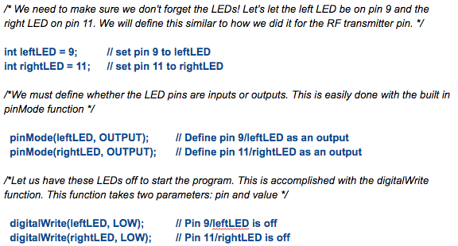

Slide 18
Answer Key: Part 2 (Comments and syntax)

Slide 19
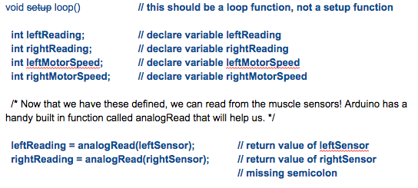

Slide 20
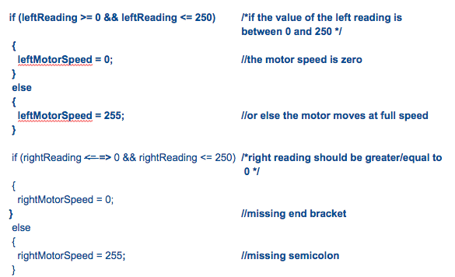

Slide 21
